Slide 1
[ 1st week Report ]
Researching Project
“ Soil Ph meter Design ”
Lecturer: Hel Chanthan
By: Nhim ChanRengSey
2019-2020

Slide 2
Outline
Hardware Diagram
Working Plan
Planning for 1st Month
4.Planning for 2nd Month

Slide 3
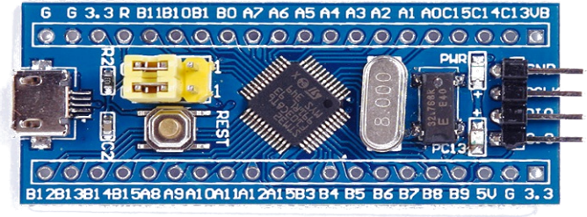
1. Hardware Diagram
STM32
Raw value
Filter
Micro- Controller
pH Sensor
Amplifier
Amp value
LCD
(display)
Page: 01

Slide 4

2. Working Plan
We will…
Learn design Filter Learn design Amplifier Choose pH sensor and LCD Learn C program Learn use STM32 Write code for configure pH sensor and LCD to STM32 Get data from sensor to LCD Build Box/Case for hardware(fusion 360)
Page: 02

Slide 5
3. Planning for 1st month
Week | Monday | Tuesday | Wednesday | Thursday | Friday | Goal
1st Week | Research | Meeting | Learn Amplifier | Presentation | Learn Filter | Learn Filter
2nd Week | Learn Filter | Learn Filter | Learn Amplifier | Learn Amplifier | Learn Amplifier | Learn Amplifier
3rd Week | Build Filter pH & LCD | Meeting Build Filter | Filter Build filter | Presentation Build Amp | Build Amplifier | Design Amplifier
4th Week | Build Amplifier | Meeting Learn stm32 | Learn STM32 Test LCD/pH | Presentation Write Code | Write Code STM32 | Start STM32
Start : 10/08/2020
Page: 03

Slide 6
4. Planning for 2nd month
Week | Monday | Tuesday | Wednesday | Thursday | Friday | Goal
1st Week | Write Code STM32 | Meeting Write Code | Write Code STM32 | Presentation Write code | Finish STM32 Code | Finish STM32 Code
2nd Week | Draw case for hardware | Meeting Draw case | Draw case for hardware | Presentation Draw case | Print 3D case | Build case Finish Job
3rd Week |  | Meeting |  | Presentation
4th Week |  | Meeting |  | Presentation
Start : 06/09/2020
Page: 04

Slide 7
THANK YOU

